Slide 1

PROJECT PHASE 1 PRESENTATION ON “Edushare-Resource Sharing Application”
2024-2025
Presented by;
Department of Computer Science And Engineering
1.Tanishk Wagh
2.Preeti Rajpure
3.Omkar Wagh
4.Mandar Shinde
Guide By;
Guide Name : Mr. Pathak.P.A
College Name: Arvind Gavali College Of Engineering Satara.

Slide 2
Agenda
Introduction
Problem Statement
Solution
Key features
Objective of The Proposed Work
Literature Review
Methodology
Software requirements
Hardware requirements
Result and discussion
Cost Estimation
Conclusion
Future Scope
References

Slide 3
Introduction
In today's digital age, the need for efficient and collaborative tools for sharing and managing notes is paramount.
Whether it's for educational purposes, professional meetings, or personal organization, having a platform that facilitates seamless note-sharing can greatly enhance productivity and collaboration.
The Resource Sharing Application is designed to fulfill this need by providing a user-friendly and feature-rich environment for creating, sharing, and collaborating on notes in real-time.
Our application can help the students to get the notes when they can enroll in our application then they will be able to get the access to the notes and they can download the notes from our site .

Slide 4
Problem Statement
In today's fast-paced and interconnected world, the need for efficient note-sharing platforms has become increasingly crucial. However, existing solutions often lack key features or suffer from usability issues, hindering effective collaboration and productivity. The Notes Sharing Application aims to address these challenges by providing a comprehensive solution that caters to the following problems:
Inefficient Resource Sharing
Lack of Personalization
Limited Collaboration Features
Fragmented User Experience
Security Concerns
Inability to Rate or Evaluate Resources
Lack of Advanced Technology Integration

Slide 5
Solution
Centralized Resource Sharing Platform – Provide an organized, user-friendly system for easy uploading, sharing, and accessing of educational resources.
Personalized Recommendations – Integrate AI and machine learning to offer customized resource suggestions based on students’ preferences and activity.
Interactive Collaboration Features – Enable peer reviews, discussions, and feedback on resources to foster a collaborative learning environment.
Intuitive User Interface – Design a simple, intuitive interface to ensure an easy and smooth user experience for all students.
Enhanced Security Measures – Implement robust security protocols, including data encryption and secure login methods, to protect user data and shared resources.
Search and Categorization – Use AI for improved search functionality, auto-categorization of resources, and predictive suggestions based on user behavior.

Slide 6
Key Features
User Registration & Authentication
Login management
User management
Notes sharing
Search functionality
Admin / user panel
Notification management
User Registration and Authentication
Resource Uploading and Management
Search Functionality
Personalized Recommendations
Secure Data Handling
Notification System
Mobile-Responsive Interface
Admin Panel
User panel
Resource Categorization and Tagging

Slide 7
Objective Of The Proposed Work
Facilitate Seamless Collaboration: The primary objective of the application is to provide a platform where users can easily collaborate on notes in real-time. This includes features such as simultaneous editing, commenting, and version control to ensure that teams can work together efficiently.
Enhance Productivity: The application aims to streamline the note-taking process and eliminate inefficiencies associated with traditional methods. By offering a centralized platform for creating, sharing, and organizing notes, users can save time and focus more on their tasks.
Ensure Security and Privacy: Security is a paramount concern for users when sharing sensitive information. The application aims to provide robust security measures to protect user data and ensure that notes are accessible only to authorized individuals or groups.
Offer Advanced Note Management Features: The application aims to provide comprehensive note management features, including organization, search, and customization options. Users should be able to categorize notes, tag them for easy retrieval, and quickly search through their entire note library.
Ensure Reliability and Performance: A key objective is to ensure that the application is reliable, stable, and performs well under various conditions. This involves rigorous testing, optimization, and ongoing maintenance to provide a seamless user experience.

Slide 8
Literature Review
Sr.No | Author Name | Paper Name | Production Year | Technology Used
1 | IEEE contributors | Empirical Study of Most Popular PHP Frameworks | 2019 | PHP frameworks (e.g., Laravel, CodeIgniter, Symfony) Proposes a PHP framework for improving modularity and performance
2 | Xiaoming Chen, Jian Zhang | The Applications of PHP, HTML, and MySQL in Development of Website – Query Function | 2021 | PHP, MySQL, HTML Discusses PHP's integration with databases and web interfaces
3 | Helene L Teitelbaum | Resource Sharing Platforms in the Digital Era | 2023 | Strategies for developing robust resource-sharing platforms using open-source PHP
4 | IEEE contributors | A Systematic Review of Collaborative Digital Platforms | 2023 | PHP and Angular for designing platforms that enhance digital collaboration and resource sharing

Slide 9
Literature Review
Sr.No | Author Name | Paper Name | Production Year | Technology Used
5 | Faculty of Language Studies and Human Development | An Urban and Rural Educational Resource Sharing and Exchange Platform Based on Cloud Platform Access Technology | 2023 | Cloud computing and network platforms Proposes a cloud-based educational resource-sharing platform designed to connect urban and rural schools, facilitating the exchange of high-quality educational materials
6 | Majid Zamiri and Ali Esmaeili | Methods and Technologies for Supporting Knowledge Sharing within Learning Communities: A Systematic Literature Review | 2023 | Diverse methods including collaborative learning platforms and online forums
7 | Andreas F. Molisch Geoffrey Hinton | Evolution of Resource Sharing Cooperation Based on Reciprocity in Peer-to-Peer Networks | 2024 | Examines how reciprocity models impact resource sharing in P2P social networks, providing insights into optimizing voluntary contributions and allocation mechanisms

Slide 10
Software Requirements :
For a Resource sharing application developed using HTML, CSS, and PHP, you’ll need a combination of software tools and technologies to build, deploy, and maintain the application. Below are the essential software requirements.
Frontend: html css and javascript
Backend: php
Database : mysql

Slide 11
Hardware Requirements
For a Resource sharing application built using HTML, CSS, and PHP, the hardware requirements are relatively modest, as these technologies primarily run on the server-side and are not resource-intensive. However, the hardware specifications may vary based on factors such as expected traffic volume, database size, and additional features. Here's a basic outline of the hardware required:
Processor: A multi-core processor (e.g., Intel Core i5 or equivalent) to handle simultaneous requests efficiently.
RAM: At least 2GB of RAM, although more may be required for larger applications or higher traffic volumes.
Storage: SSD storage for faster data access and improved application performance.
Operating System: Linux-based operating systems like Ubuntu or Debian are commonly used for hosting PHP applications due to their stability and compatibility with PHP
Database Server:
If your application uses a database ( MySQL, ), you'll need a separate server or instance to host the database.

Slide 12
Result And Discussion
User Feedback and Usage Statistics:
We conducted user testing sessions and collected feedback from participants regarding their experience using the Notes Sharing Application. Overall, the response was positive, with users appreciating the intuitive user interface, real-time collaboration features,
Effectiveness of Collaboration Features:
The real-time collaboration features of the application, including simultaneous editing, commenting, and version control, were found to be effective in facilitating teamwork and productivity. Users reported that these features streamlined communication
Security and Privacy Considerations:
Security measures implemented in the application, such as encryption protocols, access control mechanisms, and data storage practices, were evaluated for their effectiveness in protecting user data and ensuring privacy.
User-Centered Design and Usability:
The user-centered design approach employed in the development of the application was found to be effective in creating an intuitive and user-friendly interface. Usability testing revealed areas for improvement
User registration
User login
Notes Download
Notifications
Admin Notes sharing
User management

Slide 13
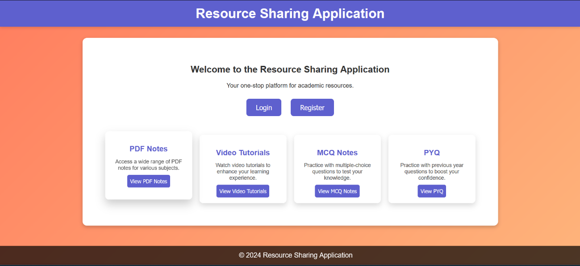
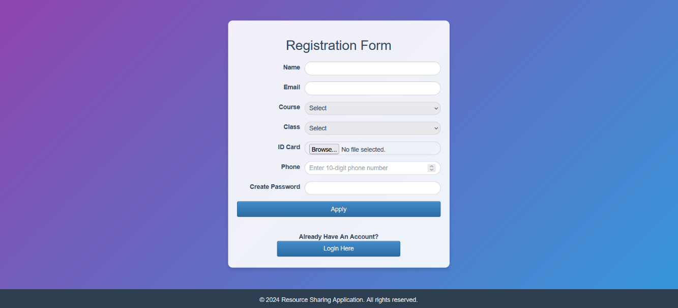
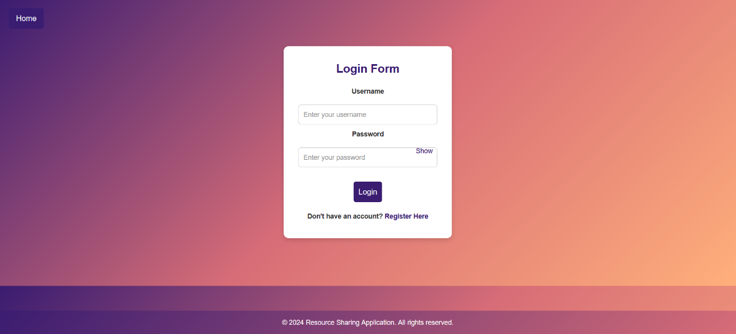
Project Snapshots
1) Homepage
2) SignupPage
3) LoginPage

Slide 14
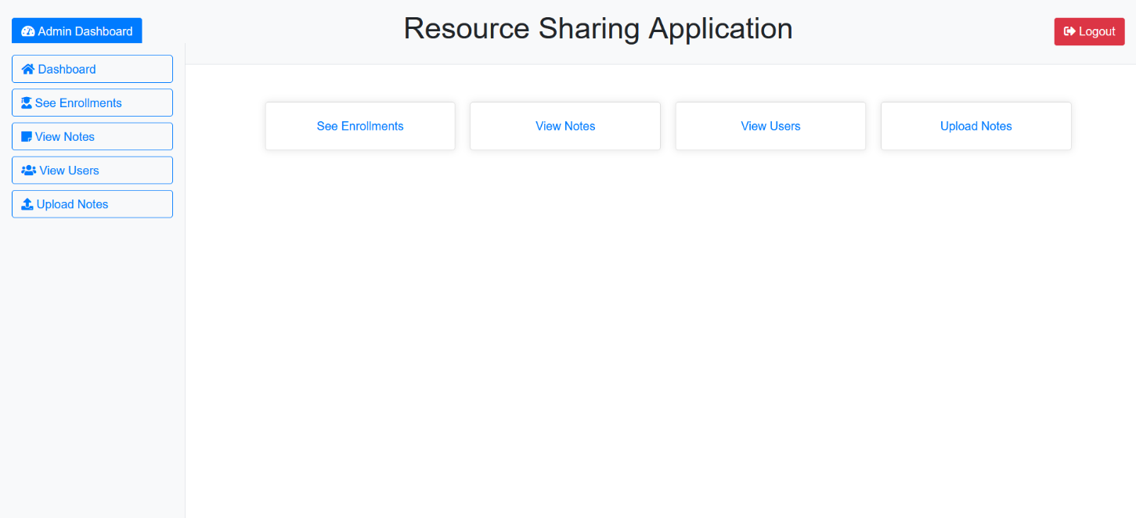
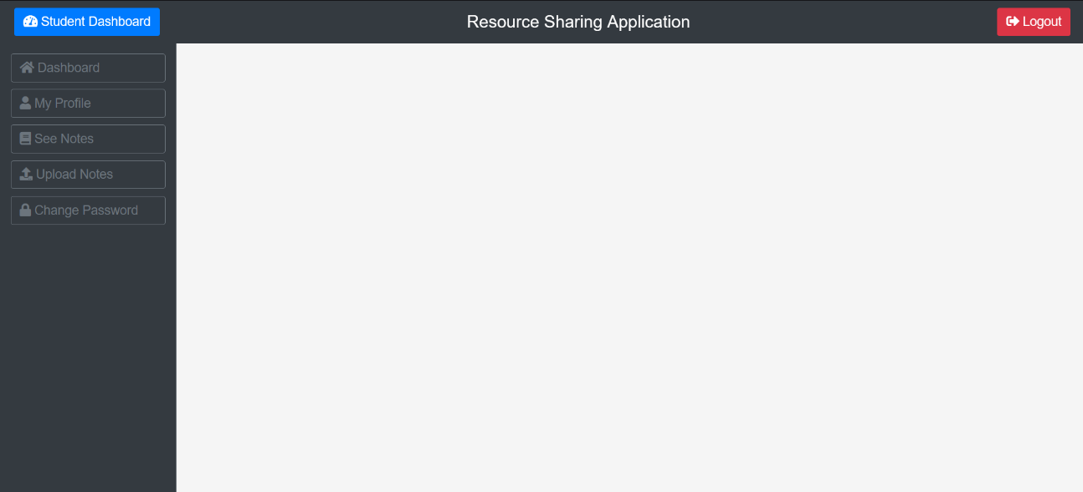
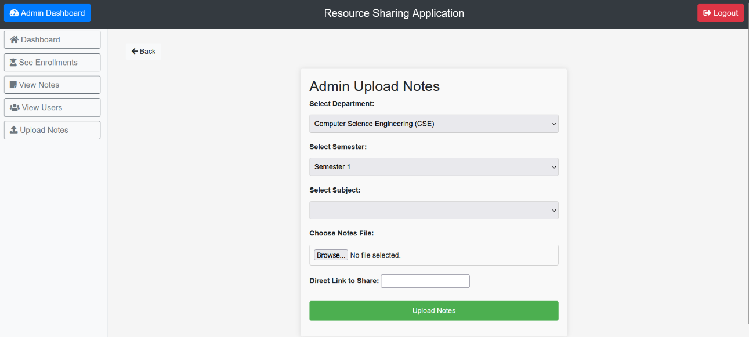
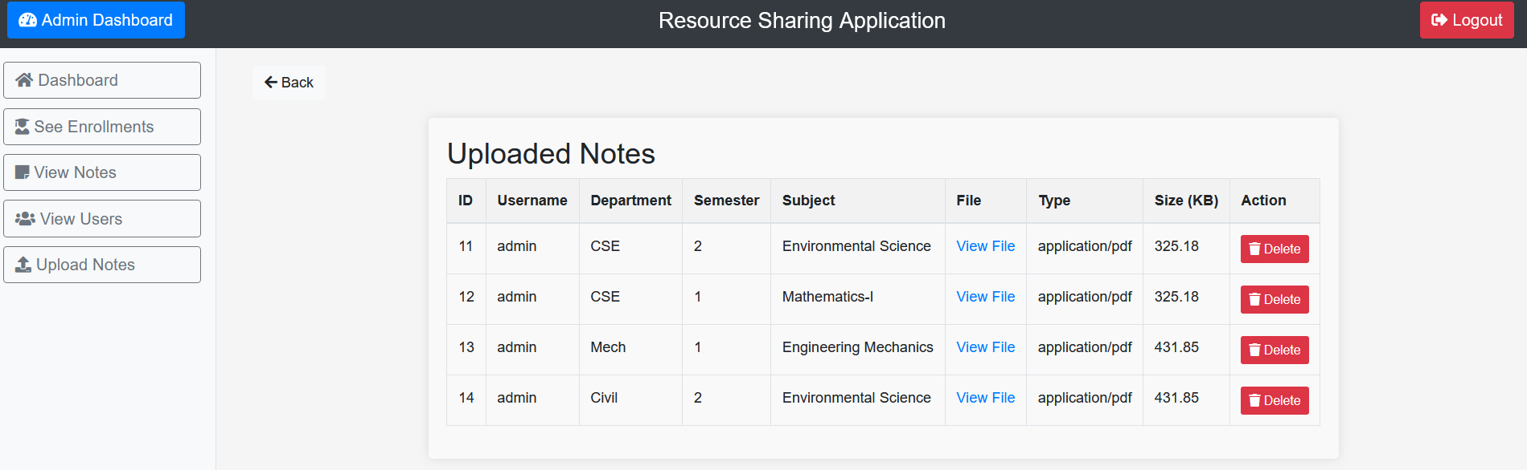
4) Admin Dashboard
5) User Dashboard
6) Notes Upload
7) View Notes

Slide 15
Cost Estimation
Product | Unit | Price
Vs code | 1 | -
Xampp server | 1 | -
Mysql database | 1 | -
StarUml | 1 | -
Total | 4 | 10,000/-

Slide 16
Conclusion
In conclusion, the Resource Sharing Application has achieved its objectives of providing a collaborative, secure, and user-friendly platform for sharing and managing notes. By fostering collaboration, enhancing productivity, and prioritizing user experience, the application has become an indispensable tool for individuals and teams seeking to streamline their note-taking process and work more effectively togethe

Slide 17
Future Scope
While the Notes Sharing Application has achieved significant milestones in its development and implementation, there are several avenues for future growth, innovation, and expansion. The future scope of the application includes:
Integration of Advanced AI Capabilities
Enhanced Collaboration Features
Mobile Optimization and Offline Access
Integration with Productivity Tools
Enhanced Security and Compliance
Customization and Personalization
Analytics and Reporting

Slide 18
References
1. IEEE contributors, “Empirical Study of Most Popular PHP Frameworks”, 2023. Discusses PHP frameworks (e.g., Laravel, CodeIgniter, Symfony) and proposes a PHP framework for improving modularity and performance.
2. Xiaoming Chen, Jian Zhang, “The Applications of PHP, HTML, and MySQL in Development of Website – Query Function”, 2023. Explores PHP's integration with databases and web interfaces.
3. Helene L. Teitelbaum, “Resource Sharing Platforms in the Digital Era”, 2023. Provides strategies for developing robust resource-sharing platforms using open-source PHP.
4. IEEE contributors, “A Systematic Review of Collaborative Digital Platforms”, 2023. Explores PHP and Angular for designing platforms that enhance digital collaboration and resource sharing.
5. Faculty of Language Studies and Human Development, “An Urban and Rural Educational Resource Sharing and Exchange Platform Based on Cloud Platform Access Technology”, 2021. Proposes a cloud-based educational resource-sharing platform to connect urban and rural schools.

Slide 19
Thankyou

